Slide 1

Cry-Sys
Made by:- Jeet Atul patel
iu1841050018

Slide 2
Introduction
Cry-Sys will be a complete cryptocurrency management system in which the user will be able to view the latest real time updating crypto currency news and will be able to manage their crypto portfolio.
Functionalities:
Real time updating crypto news network
Top 10-20 crypto currency ( Market Capital ) and real time price update
Price lookup and chart feature ( max 1 year )
User login and support team feature
Post login : crypto portfolio management

Slide 3
More INFO about post login feature
Ability to add crypto inside their account
Ability to create a “Take Profit” price (email when price will hit)
Ability to create a “Stop Loss” (email when price will hit)
Ability to add a price when the user wish to enter the crypto
Future work :
addition of new crypto scans ( daily, weekly or monthly scans based on price parameter)
Subscription for advanced scans

Slide 4
Technologies
Html, CSS, JavaScript
Bootstrap
Django
Node JS
Python v3
SQLite
Pycharm
API : https://p.nomics.com/cryptocurrency-bitcoin-api
API : https://min-api.cryptocompare.com/documentation

Slide 5
Project Report:
Week 1 : Introduction about Cry-Sys
Login and other functionalities that will be provided in Cry-Sys
Technologies Used
Week 2 : Creating basic layout of Cry-Sys
Development of basic layout of the web application

Slide 6
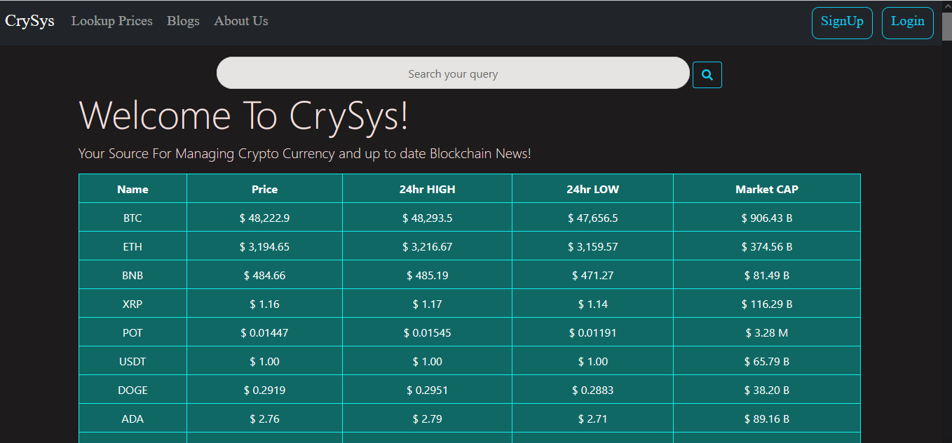
Project Report:
Week 3: Developed real time news network & Crypto data
Remaining

Slide 7
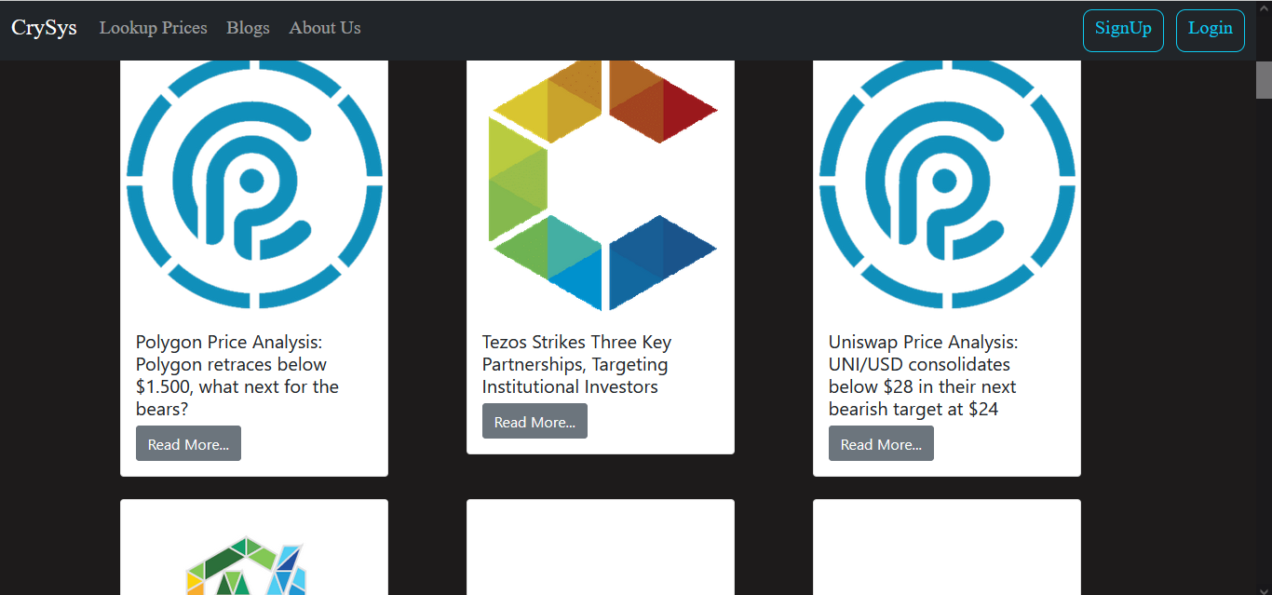

Slide 8
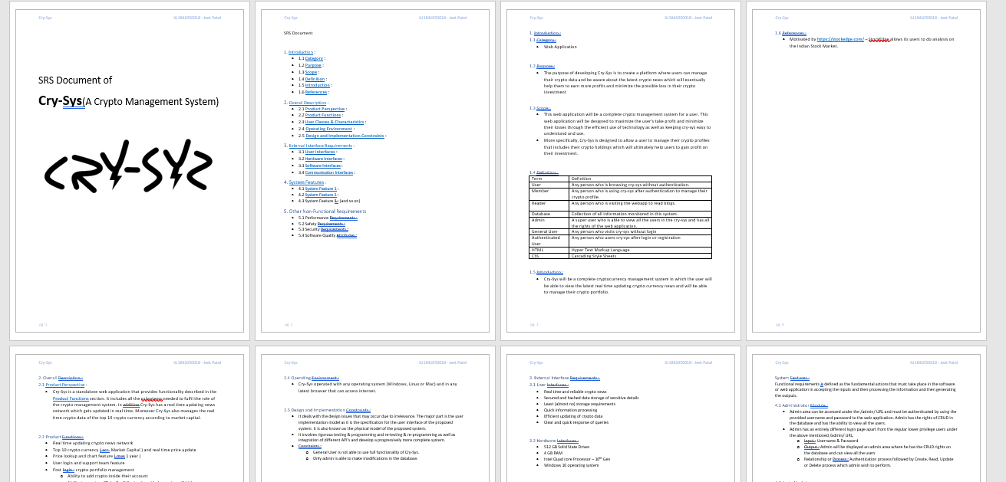
Project Report:
Week 4:
Developed SRS Document
Improved Design of Cry-Sys
Added Registration Page & Login Page

Slide 9
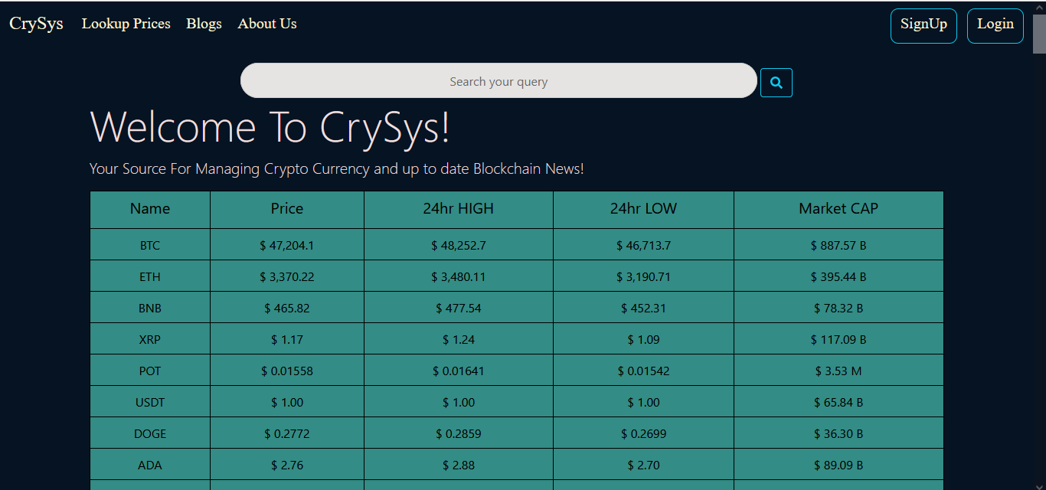
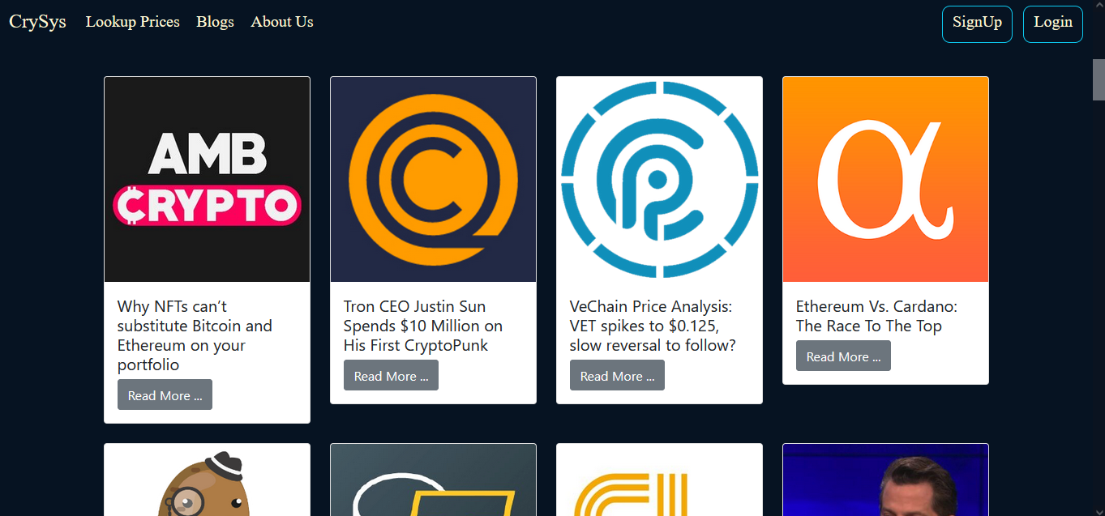
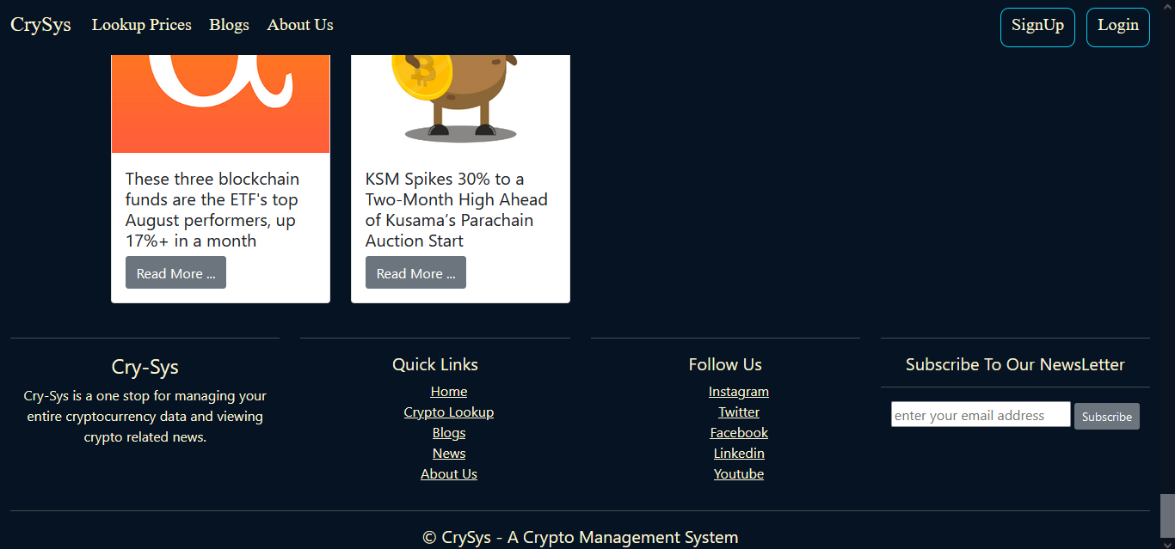

Slide 10
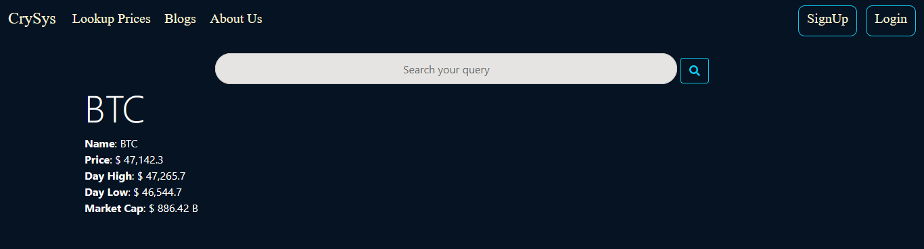
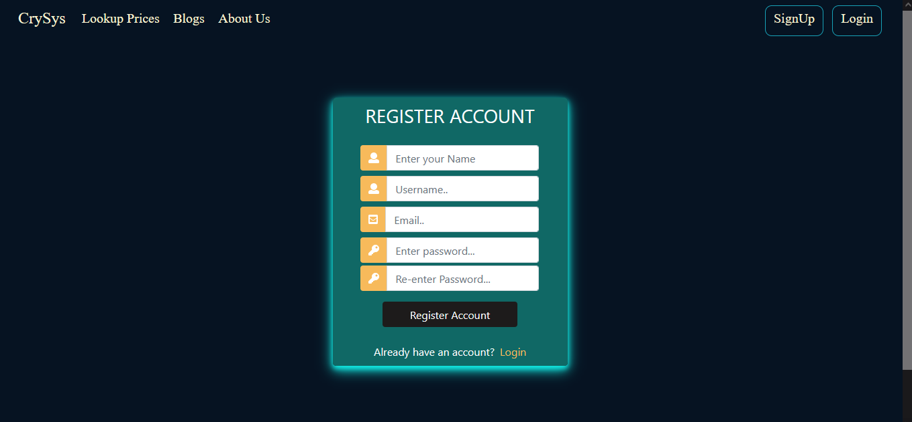
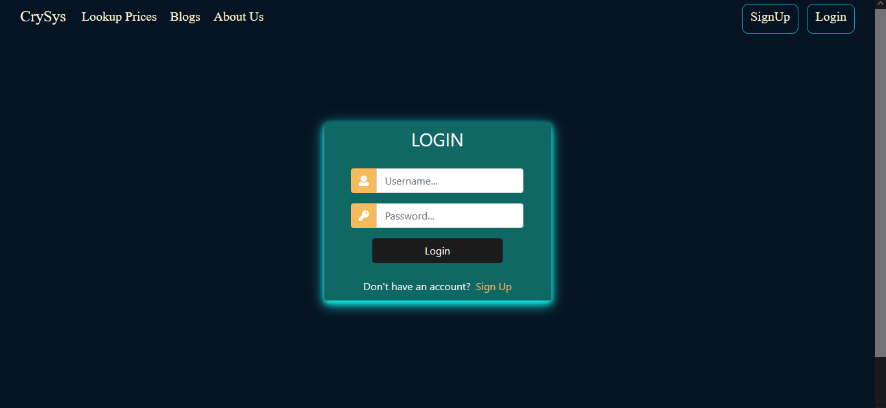

Slide 11
Project Report
Week 5:
Creation of Models
Set up of forms
Starting the Django admin area (restricted for admin access only)

Slide 12
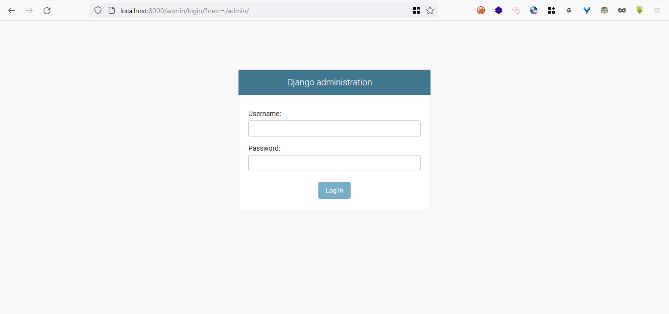
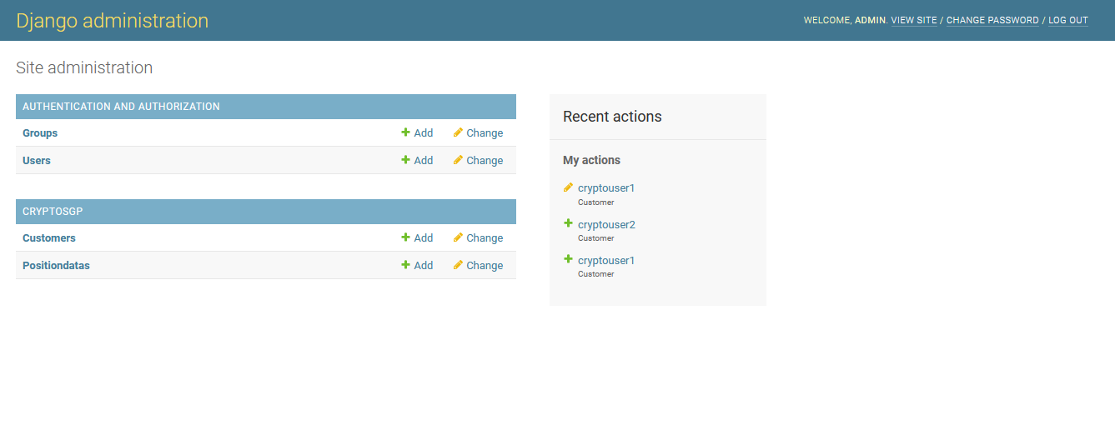

Slide 13
Project Report
Week 6:
Debugging (Register Page & Login Page fixed)
Created AccessPage

Slide 14
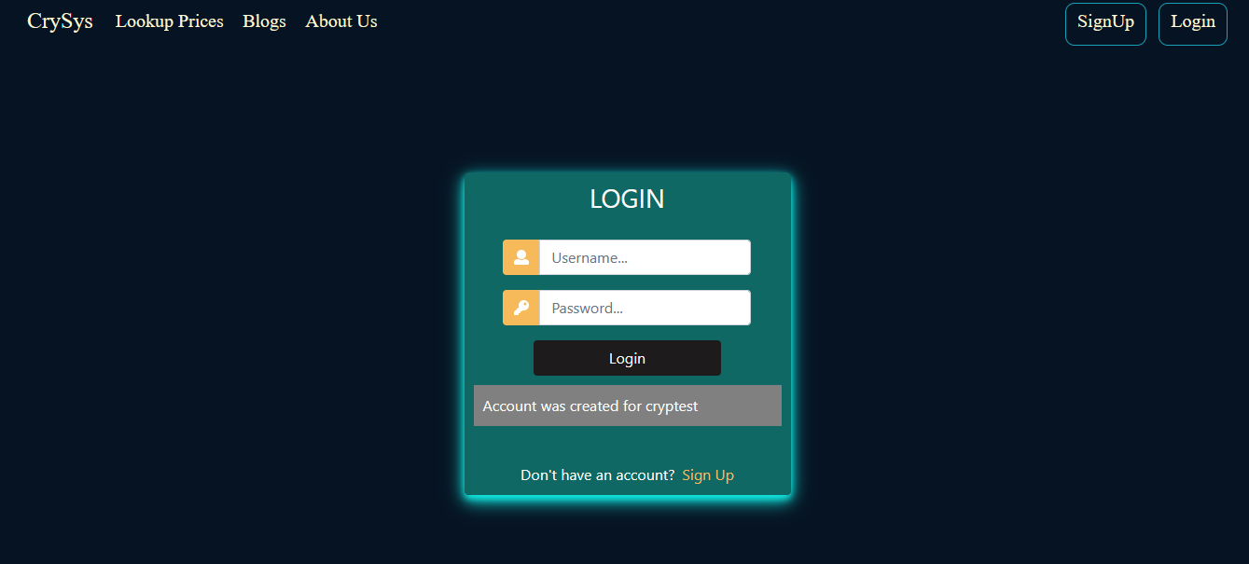

Slide 15
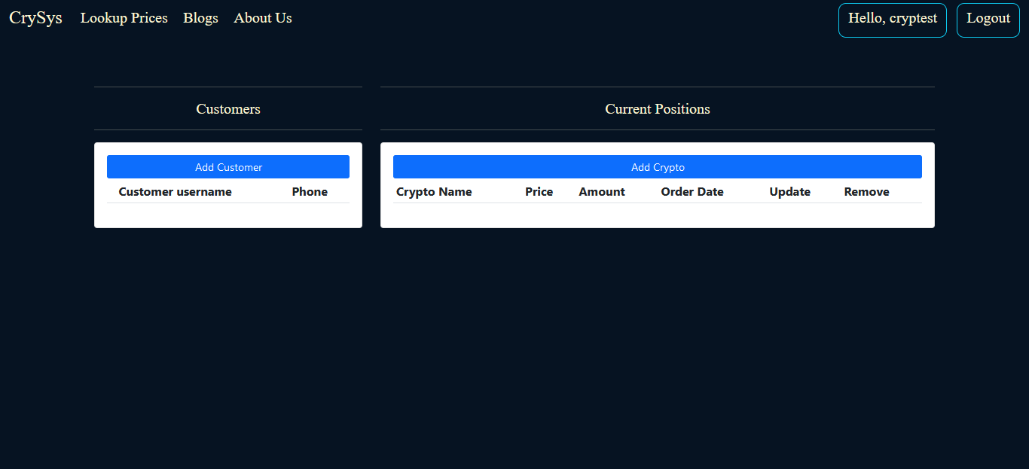

Slide 16
Project Report
Week 7:
Cleaned the code and redesigned Cry-Sys
Added Blogs Page
Added About Us Page
Created middleware for restrictions
Debugging of admin page
Made Cry-Sys responsive for tablet and mobile version

Slide 17
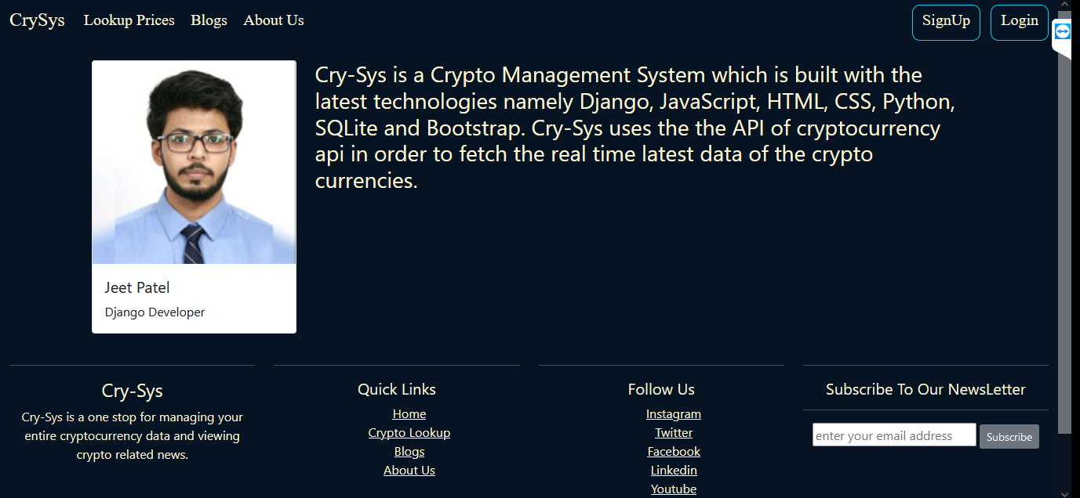

Slide 18
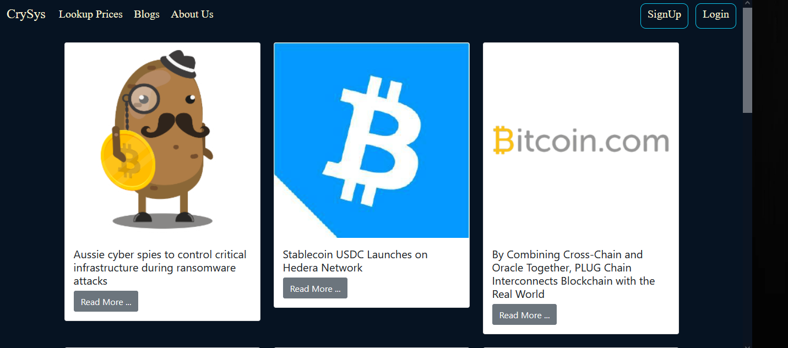

Slide 19
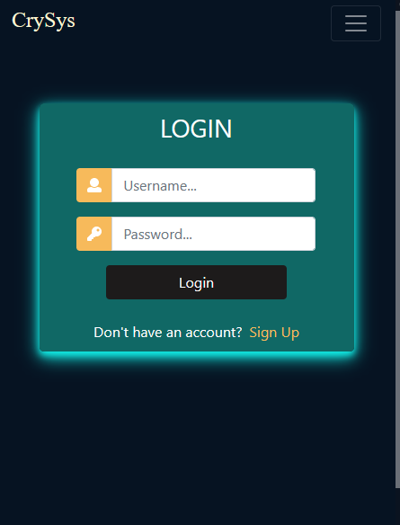
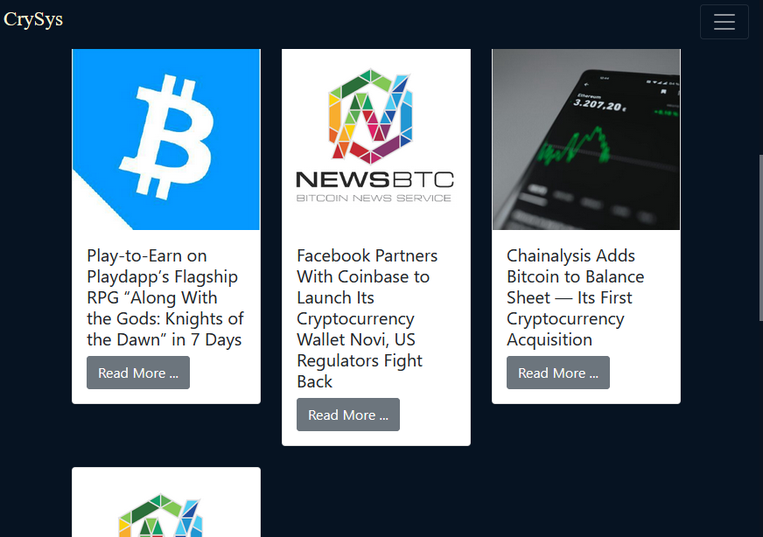

Slide 20
Future Work:
Adding Crypto Prediction Model
Adding subscription based options

Slide 21


